Slide 1



Core Java
Core Java
Java I/O – Part 2
LEVEL – PRACTITIONER

Slide 2
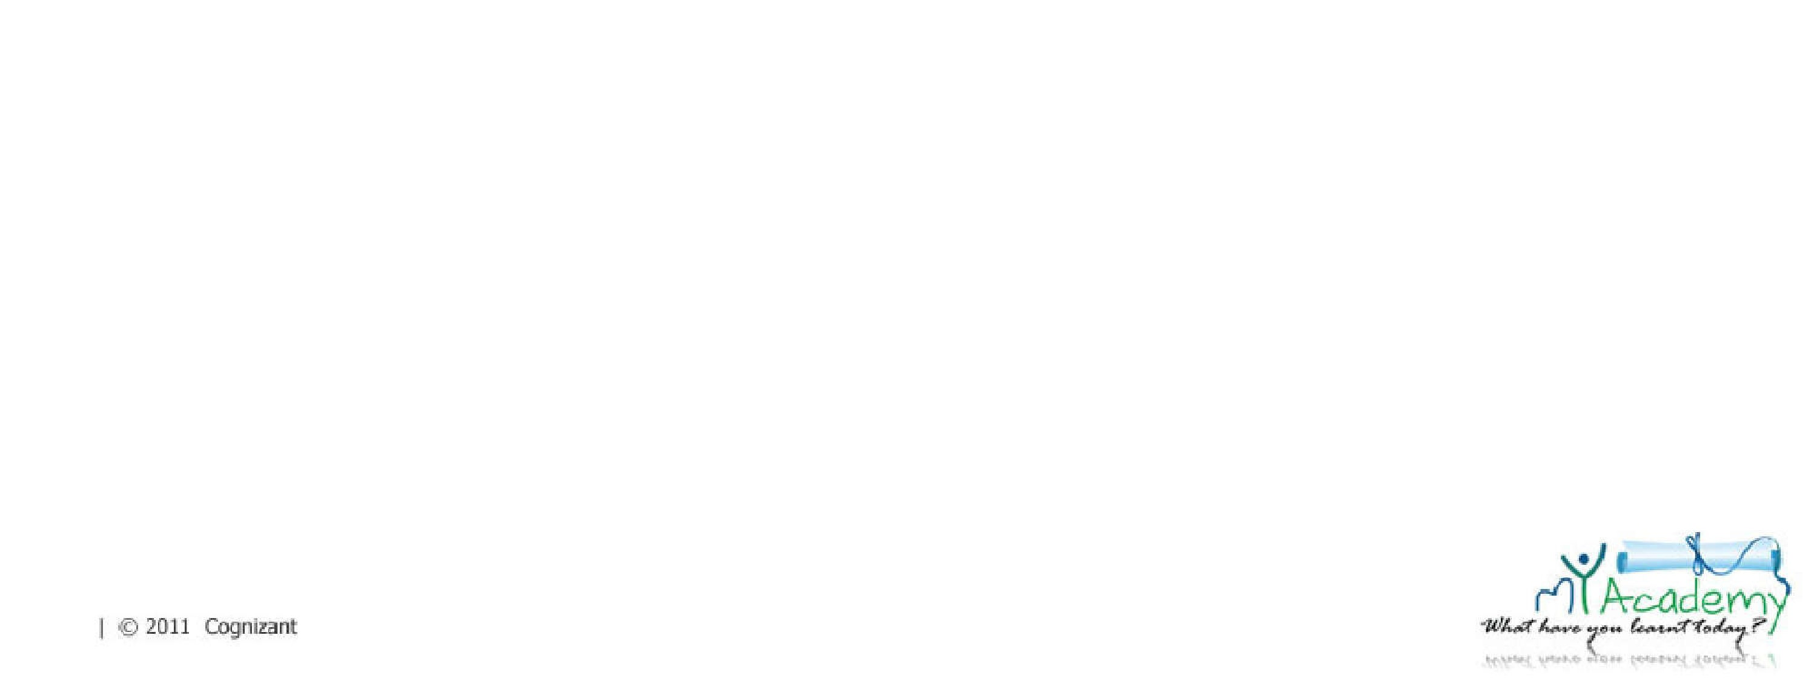
Objectives
After completing this chapter you will be able to understand,
What is a Character Stream?
Types of Character Streams.
How to read write files using character streams?

Slide 3
Character Streams
Character streams are used to read write data as character type(16 bit Unicode) data .
All character stream classes are the sub classes of the following two abstract classes,
Reader :The base class which contains the common methods for reading characters.
Writer : The base class which contains the common methods for writing characters.

Slide 4
Reader
A Reader class is used by a Java programs to read character data from a source.
Reader class is an abstract class available in java.io package.
Reader class is the super class of all classes representing an input stream of characters.
Java IO package provides various implementations of Reader class.

Slide 5
Methods of Reader class
Method | Description
int read() | Reads a single character.
Int read(char []cbuf) | Reads characters into an array
int read (char[] cbuf, int offset, int length) | Reads characters into a portion of an array
boolean ready() | Tells whether this stream is ready to be read.
void close() | Closes the stream and releases any system resources associated with it.
void mark(int position) | Marks the present position in the stream.
int skip(long char) | Skips characters
7

Slide 6
Reader Class Implementations
Listed below are the different Reader objects, In this session we will focus on
BufferedReader and FileReader.
BufferedReader
BufferedReader
CharArrayReader
CharArrayReader
Reader
Reader
InputStreamReader
FileReader
InputStreamReader
FileReader
StringReader
NOTE: Associates are requested to go through the java documentation to understand about the other stream objects.
StringReader

Slide 7
File Reader
The FileReader class is used for reading data as characters from a file.
Example:
FileReader reader=new FileReader(“info.txt”);
Note: An exception named FileNotFoundException is thrown if the file is not present in the specified location.

Slide 8
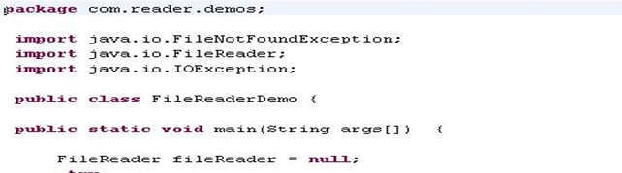
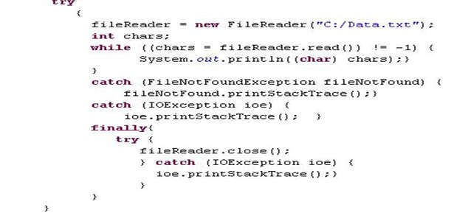
File Reader Example
Creating a new file reader and open the file.
Reads the file character by character.

Slide 9
BufferedReader
BufferedReader reads the character from a character input stream.
BufferedReader is more efficient than the FileReader in reading data from file.
Example:
BufferedReader reader = new BufferedReader(new
FileReader(“C:\Data.txt"),100);
The above example creates a buffering character-input stream that uses an input buffer of size 100 bytes.

Slide 10
Methods of BufferedReader
Method | Description
int read() | Reads a single character from character-input stream
int read(char[] cbuf) | Reads characters into an array.
String readLine() | Reads a line of text.
int read(char[] cbuf, int off, int len) | Reads characters into a portion of an array.
void close() | Closes the stream and releases any system resources associated with it.

Slide 11
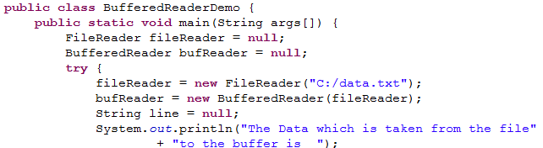
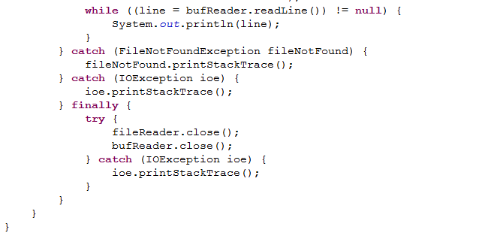
BufferedReader Example
Creating a buffered reader for the file reader object.
Reads the file line by line

Slide 12
Lend a Hand – Buffered Reader
Objective: Learn how to use Buffered Reader for reading files.
Prerequisite: Create a file named data.txt and type some data into it.
Exercise: Print the file content in the reverse order.
Create a class named FileReverseReading.java with a main method. The main method should reverse the contents of a file and print the reversed String to the console. The file should be read using a BufferedReader.
Expected Output:
“The Reversed File Content is” <reversed content>.

Slide 13
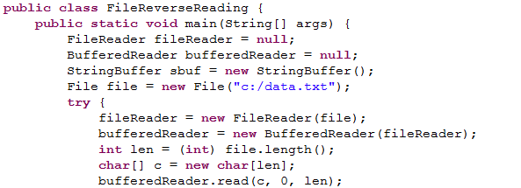
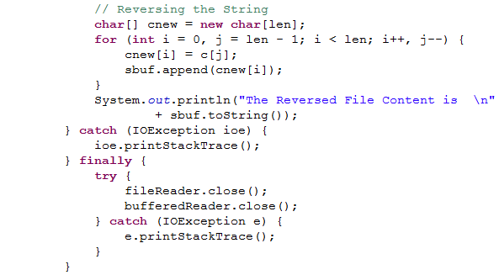

Lend a Hand Solution

Slide 14
Writer
An Writer class is used by a Java Program to write character data to a destination.
Writer class is an abstract class available in java.io package.
Java.io package holds the implementation classes of Writer class.
Implementation of the writer class are used to write data to a file,a character array, a network socket ,etc.

Slide 15
Methods of Writer
Method | Description
void write(int c) | Writes a single character.
void write(char[] cbuf) | Writes an array of characters.
void write(char[] cbuf, int off, int len) | Writes a portion of an array of characters.
void close() | Closes the stream, flushing it first. Once the stream has been closed

Slide 16



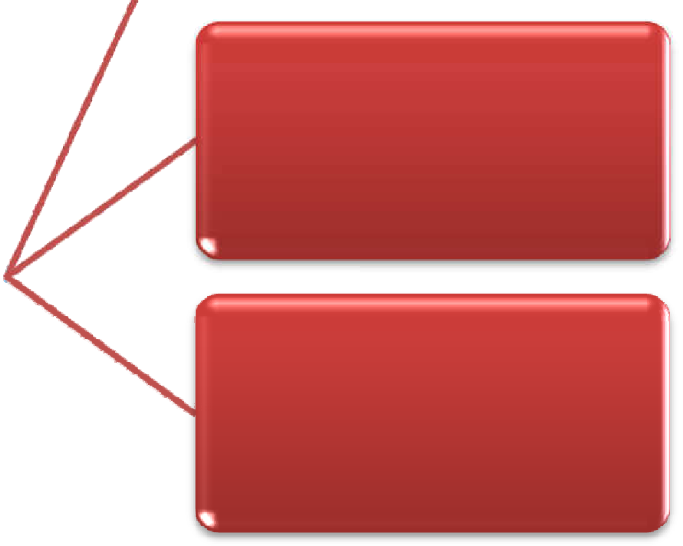


Writer Class Implementation
Listed below are the different Writer objects, In this session we will focus on
BufferedWriter and FileWriter.
BufferedWriter
FileWriter
CharArrayWriter
Writer
CharArrayWriter
Writer
NOTE: Associates are requested to go through the java documentation to understand about the other stream objects.
OutStreamWriter
StringWriter

Slide 17
FileWriter
The FileWriter class is used to write the contents to a file.
Example:
FileWriter writer=new FileWriter (“info.txt”);
The above example writes content to info.txt file.

Slide 18
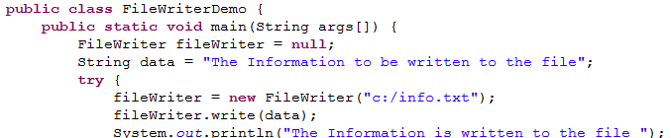
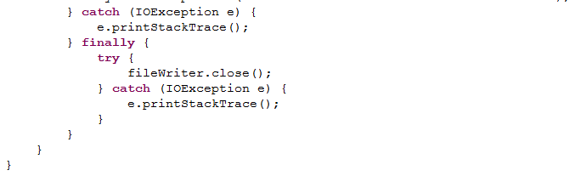
FileWriter Example
Creating a File Writer Object.

Slide 19
BufferedWriter
BufferedWriter writes the character to character output stream.
As name indicates BufferedWriter uses buffer for writing content to files. So this is efficient than the other character output streams.
The argument for BufferedWriter is any other character stream
Example:
BufferedWriter writer= new BufferedWriter (new FileWriter(“C:\Data.txt”,100);
The above example creates a new buffered character-output stream that uses an output buffer of the given size specified size of 100 bytes.

Slide 20
Methods of BufferedWriter
Method | Description
write(int c) | Writes a single character..
write(char[] cbuf, int off, int len) | Writes a portion of an array of characters.
write (String str, int off, int len) | Writes a portion of a String.
Void flush() | Flushes the stream.
void close() | Closes the stream, flushing it first.

Slide 21
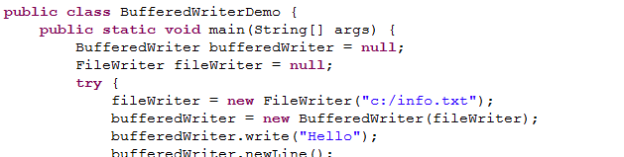
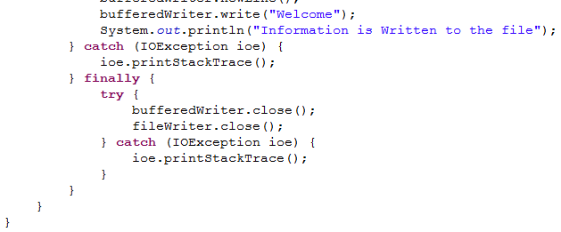
BufferedWriter Example
Creating a Buffered Writer Object.

Slide 22
Lend a Hand – BufferedWriter
Objective: Learn how to use Buffered Writer for writing files.
Exercise: Create a class named BufferedWriterEmailReg.java with a main method which will take the data from console and write to a file .The name of the file should be newFile.txt.
Main method logic:
Create the object of FileWriter class and pass the path and name of the file as argument.
Create the object of BufferedWriter and pass the reference of FileWriter to it. 3.Create an object of scanner class and get the name and email id from the console. Append the inputs in the below format
"Welcome " <name> ", Thank you for registering your email id,
<email>

Slide 23
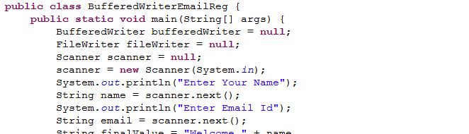
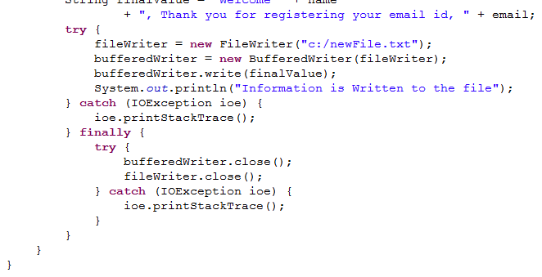
Lend a Hand Solution– BufferedWriter

Slide 24

Other Character Stream Implementation
InputStreamReader - class used for converting byte streams to character streams.
StringReader - class is used for reading characters from a String.
CharArrayReader - class is used for reading characters from a character array.
OutputStreamWriter - class used for converting character streams to byte streams.
CharArrayWriter - class is used for writing characters to a character array.
Associates based on their needs can use the appropriate readers and writers to develop applications in their projects.

Slide 25


Core Java
You have successfully completed – Java I/O – Part 2

